Slide 1
Border Detection system for fisherman using Gps and arduino
By sk. Mohammad yaseen
Ece
170041002

Slide 2
Objective
Aim:- This project will be guiding the fisherman crossing the local borders and preventing them not to cross the local border and using IOT applications in packaging unit

Slide 3
Abstract
There has been several cases where the ignorant and poor fishermen of Tamil Nadu have unknowingly and due to lack of technical equipment and knowledge have crossed the international border of sea and has been arrested by Sri Lankan Naval Forces on the accusation of terrorism.
These innocent fishermen with no fault of theirs get caught and get severe punishment for the fault they don’t know about.
Countries with the international marine time boundary line (IMBL) will always have security problems and continuous life threatens for those fishermen whose family’s main economic support is fishing.
Even in the peninsular country like India has their boundary limit in the ocean, the people of these coastal regions has the main work of fishing, due to carelessness or without knowing their boundary limit of their country they cross the borders.
So in order to solve this problem, our group took this as a challenge and we have found an easy and feasible way to solve this problem in which the fishermen would be given certain signals and a buzzer would sound as soon as they approach the border and thus they can remain at safe distance from the border. This would greatly help the poor and innocent fishermen to remain within the Indian borders and continue their work.

Slide 4
advantages
Death rate will be decreased and fisherman’s life can be increased .
Prevent them from crossing other country border.
This system saves the life of many fisherman suffering due to border issues.
Alerting the captain if he/she is going to cross the border line.
This project can save the lives of many fisherman.

Slide 5
Changes that has made to this project
We have fixed some sensors at packaging unit.
Weighing sensors were added at loading unit.
We will assign certain load according to the vehicle’s load
When it reaches the maximum weight an alarm will be given to the unit who are working in this.
This alarm indicates that the vehicle has reached it’s maximum loading capacity. Kindly allow other vehicle to load the particulars and vice versa.

Slide 6
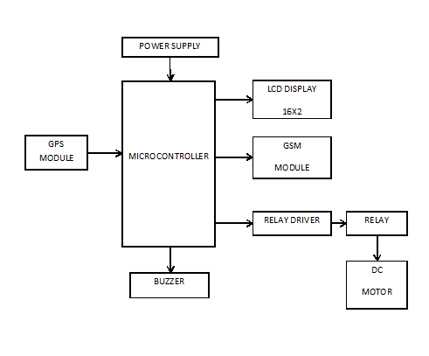



Sample Block diagram

Slide 7
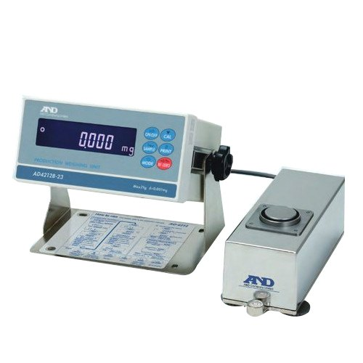
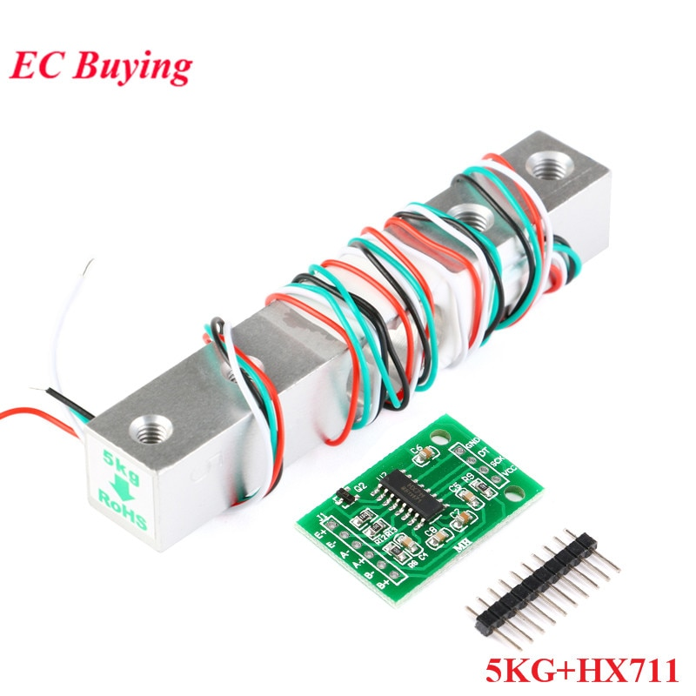
Weighing sensors

Slide 8
references
Suresh . M , Gandhi Raj S , Saranya . T , then Mozhi . S , Divya M, 2014. Border alert system for boats using Zigbee. International journal of innovative research in computer and communication engineering
[2] S. Vivek T.V. Aravind Venkatraman L Aravind Graagul , 2015. Automatic border crossing detection and navigation of boat. IJSTE - international journal of science technology & engineering | volume 1 | issue 8 | GPS-based vessel position monitoring and display system. IEEE aerospace and electronic systems magazine. 1990
[3] the accuracy of the global positioning systems. IEEE instrumentation & measurement magazine. 2004; 7(1): 56-60k. Elissa,
[4] GPS -based vessel position monitoring and display system. IEEE aerospace and electronic systems magazine. 1990
[5] Abid khan and Ravi Mishra (2012) , “GPS– gsm based tracking system” international journal of engineering trends and technology volume3 issue2

